Slide 1
Employee Data Analysis using Excel
STUDENT NAME: MOHAMMED RASULDEEN .T.A
REGISTER NO: 22315
DEPARTMENT:CORPORATE SECRUTYSHIP
COLLEGE: SIVET COLLEGE

Slide 2
PROJECT TITLE
Employee Performance Analysis using Excel

Slide 3


AGENDA
Problem Statement
Project Overview
End Users
Our Solution and Proposition
Dataset Description
Modelling Approach
Results and Discussion
Conclusion
3/21/2024 Annual Review

Slide 4

PROBLEM STATEMENT
Employee performance analysis:
It means how well the employee doing his job , or if any training should be given to get better results , if he is doing his best performance to give incentive

Slide 5

PROJECT OVERVIEW
Performance analysis
.
Here to analyse the performance of employees I used employee name , business unit, gender , performance rating
I also created a pivot table for analysing

Slide 6
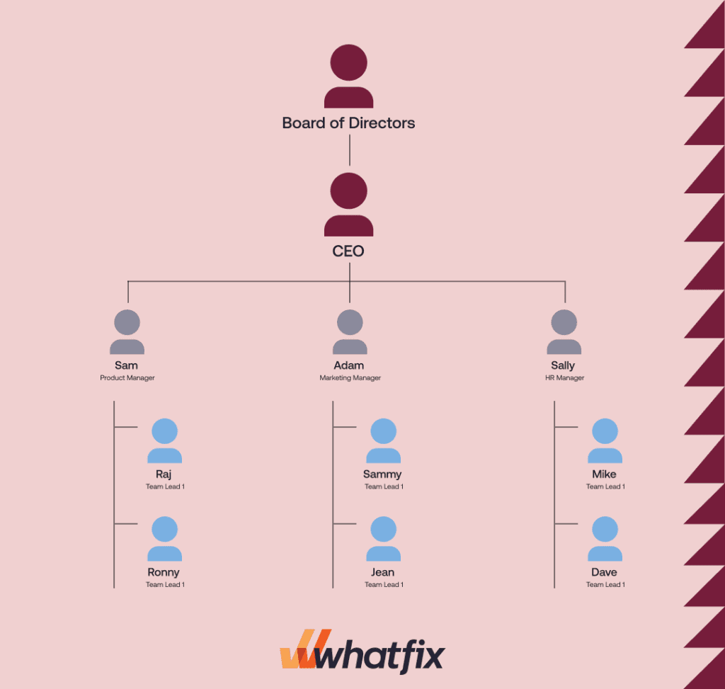

WHO ARE THE END USERS?

Slide 7

OUR SOLUTION AND ITS VALUE PROPOSITION
Conditional formatting: It is used find the missing value
Sort &filter: It is used remove missing value and to fill it.
IPS: This formula is used for multiple condition
And to rate the employee performance through this formula
Pivot table: It is used to summarize what we have done.
Graph: This is used for visual

Slide 8
Dataset Description
Employee=kaggle
26 features
9 features
Employ Id : Number
Name: Text
Business unit: Text
Employee type: full time, contract, part time
Performance level: Very high, High,Med,Low
Gender: male, female

Slide 9

THE "WOW" IN OUR SOLUTION
3/21/2024 Annual Review
9

Slide 10
MODELLING
Collecting the data , which we are going to use it
By selecting the column and filling with the colours so that it can be identified
If there are missing numbers in the column which we selected use conditional formatting to fill it .
Click on the highlights in the more rules click on blank and choose format and click colour and choose what you want
If you want to identify the missing value click on sort&filter to remove the blanks it fill the blank. Click on the column which has blank value& click on sort &filter In that click no fill to remove the blank
10

Slide 11
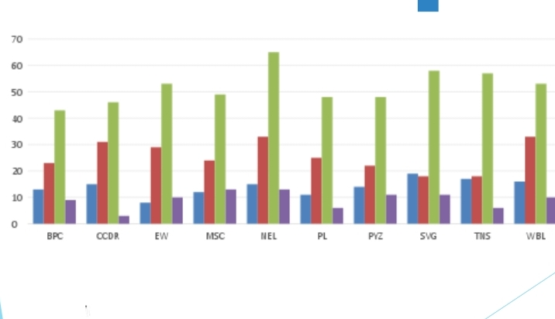
RESULTS
11

Slide 12
conclusion
From this analysing we come know about the employee performance by using excel
We also created pivot table for visualising and easy to understand

